Slide 1

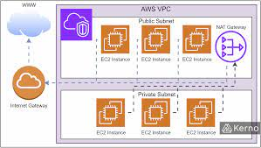
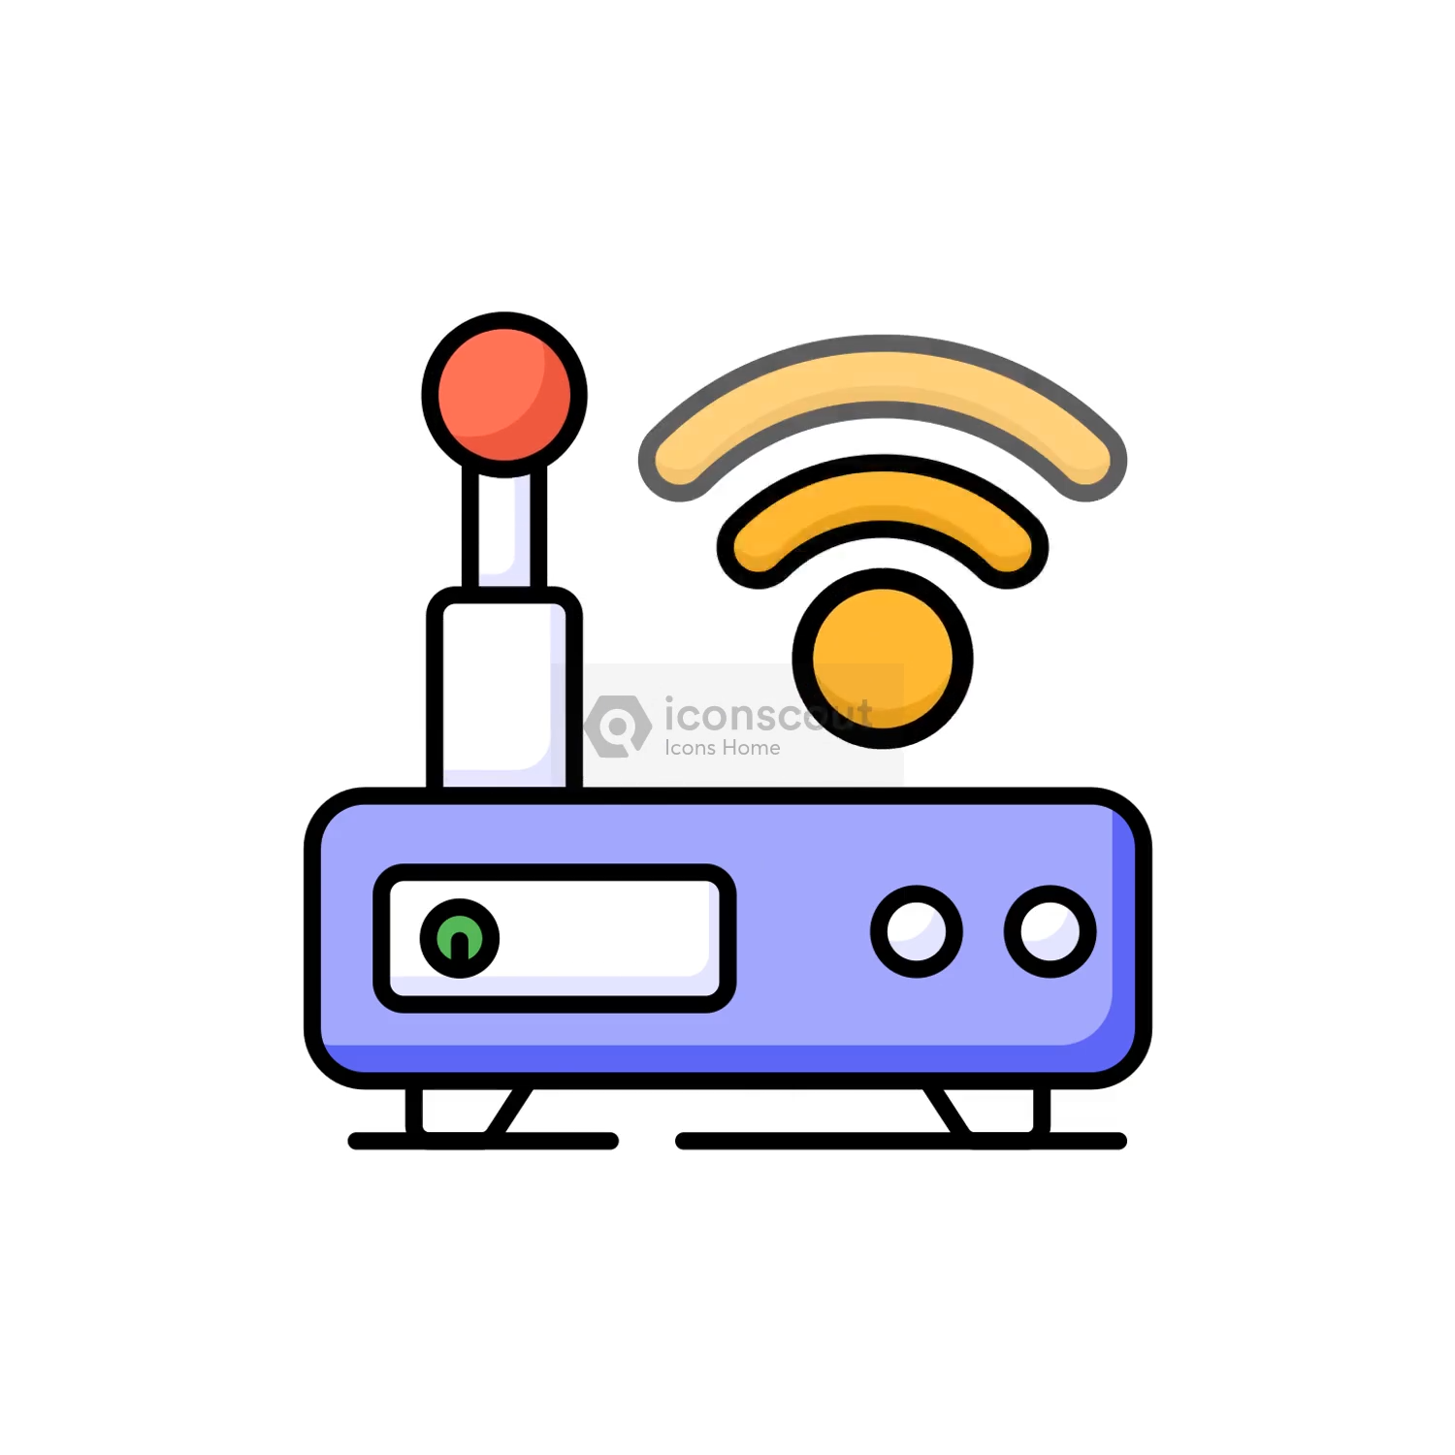
Components Of IoT nternet Of Things IOT
Remember and Compare >>>
Others ………The Ecosystem IoT
Components Internet Of Things IOT
Device(Sensor,+ MC)
Gateway, Network
Management Services Layers (Cloud)
Application layer

Slide 2
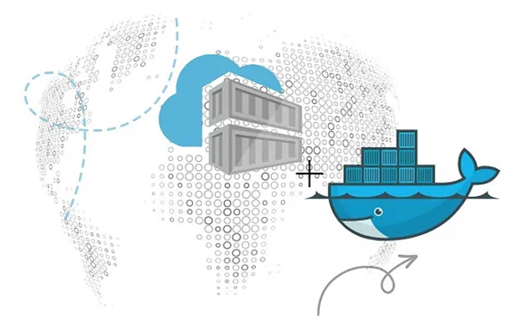
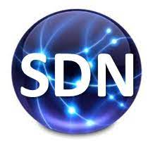
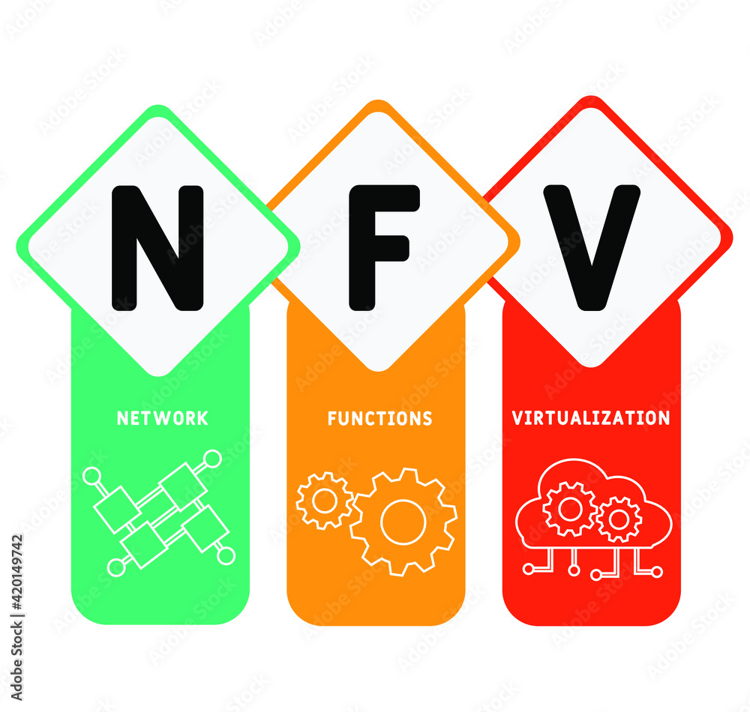
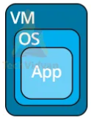
PDS
Computer Vision
Chapter 2
IoT Ecosystem
Part 2
https://github.com/siagianp
https://www.youtube.com/@AmelOline/videos
https://github.com/amelcharolinesgn2/IoT_simulator-mqtt-NodeRed
https://github.com/amelcharolinesgn2/Cloud-Infrastructures
https://github.com/amelcharolinesgn2/IoT_app-and-Modules
https://github.com/amelcharolinesgn2/ClouD-Infrastructure-SISKA-2025
Notes:
https://www.mi.fu-berlin.de/inf/groups/ag-tech/teaching/2012-13_WS/L_19528_Embedded_Internet_and_the_Internet_of_Things/08.pdf
https://www.hivemq.com/blog/mqtt-vs-coap-for-iot/

Slide 3
The IoT ecosystem (Cont’s)
The IoT Ecosystem: Sensor Device &Components, Architecture, Communication Technologies, and Protocols
There is no standard architecture for the IoT ecosystem. In this chap- ter, we have de ned a reference architecture, and we have used this architecture throughout this chapter. It is a ve-layered architecture and the di erent layers are as follows:
◾ Objects layer
◾ Object abstraction layer
◾ Service management layer
◾ Application layer
◾ Business layer

Slide 4
The IoT ecosystem
There is no standard architecture for the IoT ecosystem. In this chap- ter, we have de ned a reference architecture, and we have used this architecture throughout this chapter. It is a ve-layered architecture and the di erent layers are as follows:
◾ Objects layer
◾ Object abstraction layer
◾ Service management layer
◾ Application layer
◾ Business layer

Slide 5
The main protocols that we have tried to de ne for the infrastructure layer are the following:
◾ RPL ◾ IEEE802.15.4 ◾ 6LoWPAN
◾ Bluetooth low energy ◾ EPCglobal
◾ LTE-A ◾ Z-Wave ◾ ZigBee

Slide 6
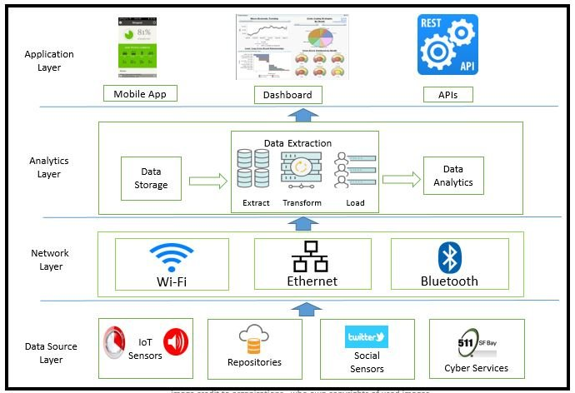
Architecture of IoT based Big data analytics end-to-end system
Notes:
https://www.researchgate.net/figure/Generic-Architecture-of-IoT-based-Big-data-analytics-end-to-end-system_fig1_317062625

Slide 7
three prominent service discovery protocols that are used for IoT devices:
◾ DNSservicediscovery(DNS-SD)
◾ Multicast domain name system (mDNS)
◾ Simple service discovery protocol (part of UPnP)

Slide 8
Layered Architecture for IoT
Busines Layer
Application Layer
Service Management
Object Abstraction
Objects

Slide 9
Objects Layer
Objects layer, also known as devices layer, comprises the physical devices that are used to collect and process information from the IoT ecosystem.
Physical devices include di erent types of sensors such as those that are typically based on micro-electromechanical systems (MEMS) technology.

Slide 10
Object Abstraction Layer
This layer transfers data that are collected from objects to service management layer using secure transmission channels. Data transmission can happen using any of the following technologies:
◾ RFID
◾ 3G
◾ GSM
◾ UMTS
◾ Wi-Fi
◾ Bluetooth low energy
◾ Infrared
◾ ZigBee

Slide 11
Service Management Layer
This layer acts as middleware for the IoT ecosystem.
This layer pairs speci c services to its requester based on addresses and names.
This layer provides exibility to the IoT programmers to work on di erent types of heterogeneous objects irrespective of their platforms.

Slide 12
Application Layer
This layer provides the diverse kinds of services requested by the customer.
The type of service requested by the customer depends on the speci c use case that is adopted by the customer.
Some of the prominent IoT verticals are as follows:
Smartcities
Smart energy
Smarthealthcare Smart buildings or homes
Smart living
Smart transportation
Smart industry

Slide 13
Business Layer
This layer performs the overall management of all IoT activities and services.
This layer uses the data that are received from the network layer to build various components such as business models, graphs, and flowcharts.
This layer also has the responsibility to design, analyze, implement, evaluate, and monitor the requirements of the IoT system.

Slide 14
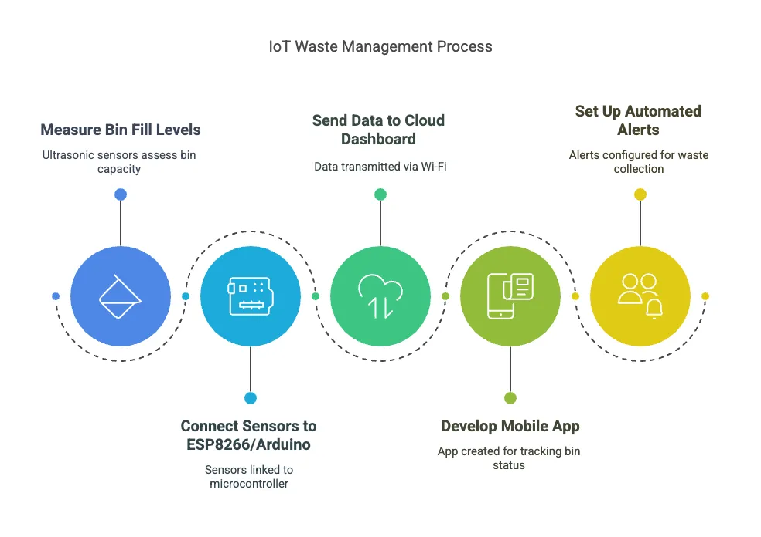
Top 50 IoT Projects to Level Up Your Tech (Includes Code!)

Slide 15
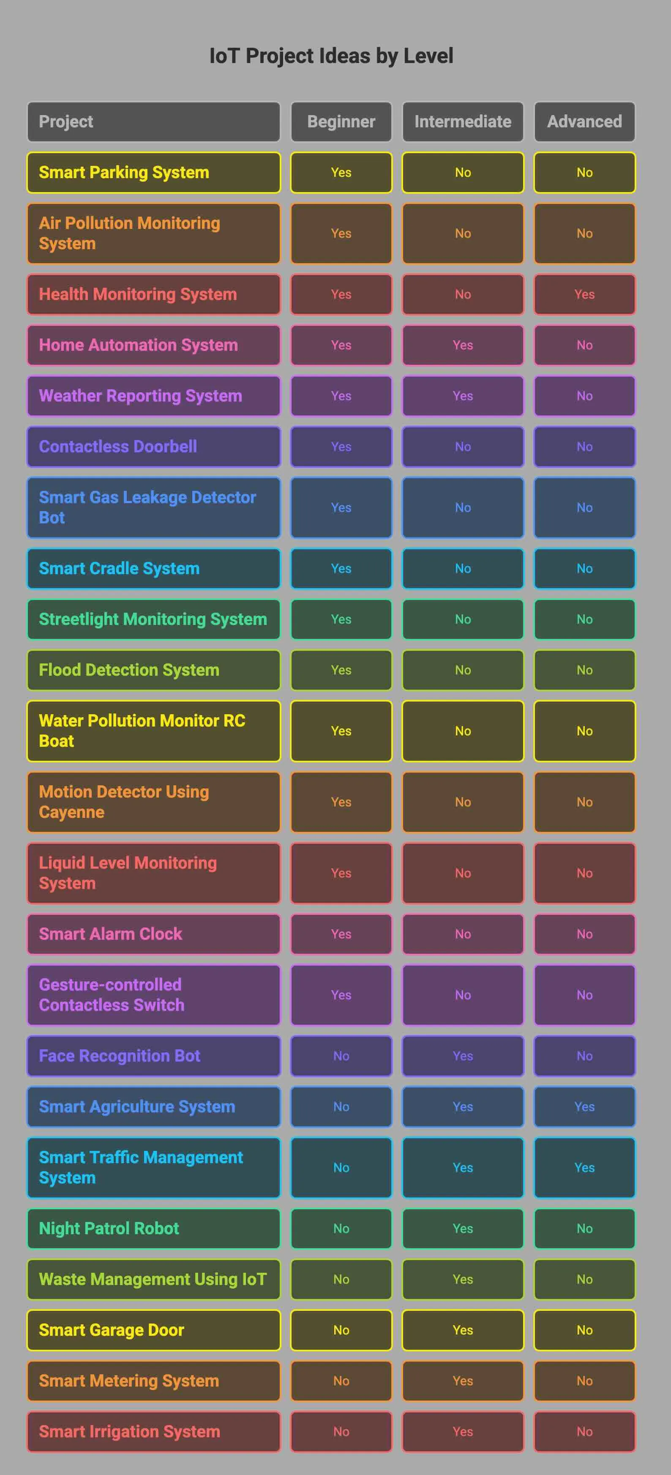

Slide 16
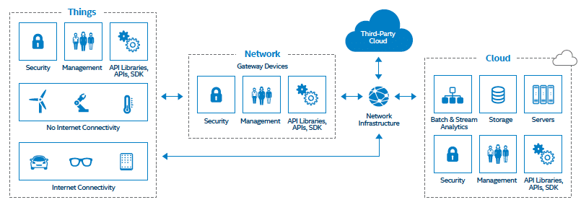
ex1
End-to-End IoT Solution
Notes:
End-to-End IoT Solution form Things to Network to Cloud.

Slide 17
References
“Internet of Things Research Study”, http://www8.hp.com/us/en/hp-news/press-release.html?id=1909050 [Hewlett Packard (2015)]
https://www.itransition.com/iot/architecture
https://www.techtarget.com/iotagenda/definition/Internet-of-Things-IoT

Slide 18
Thank you!
PDS
Computer Vision
Q&A
Thank you For being a great class!
https://github.com/siagianp
https://www.youtube.com/@AmelOline/videos
https://github.com/amelcharolinesgn2/IoT_simulator-mqtt-NodeRed
https://github.com/amelcharolinesgn2/Cloud-Infrastructures
https://github.com/amelcharolinesgn2/ClouD-Infrastructure-SISKA-2025
Notes:
https://medium.com/buildpiper/simplifying-containerization-with-docker-run-command-2f74e114f42a
https://github.com/IBA-Group-IT/IoT-data-simulator
https://www.bevywise.com/blog/docker-mqtt-broker-easy-service-manageability/

